Slide 1
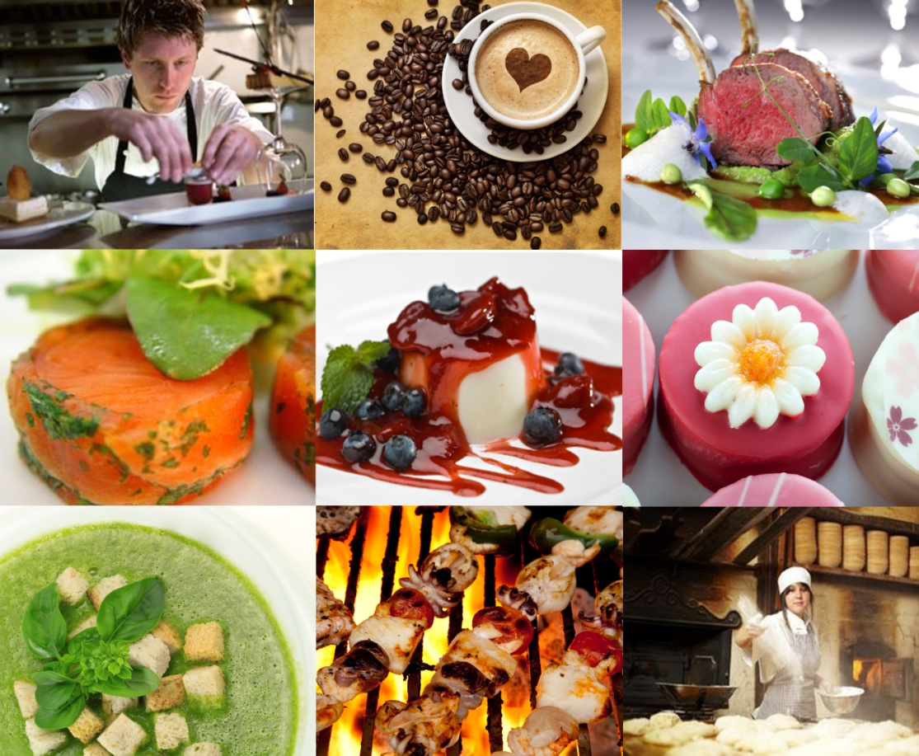
PRESENT AND DISPLAY FOOD PRODUCTS
D1.HCC.CL2.19
Notes:
Trainer welcomes trainees and informs them that the subject matter that will be covered is food presentation and display of food products.

Slide 2
Present and display food products
This unit comprises 3 elements:
1
Prepare garnishes and accompaniments
2
Plate and present foods
3
Store garnishes and accompaniments
Notes:
Trainer advises students that this unit comprises 3 elements as listed on slide explaining:
Each element comprises several performance criteria
Students can obtain more information from the Trainee Manual
The course presents advice and information but, where their workplace requirements differ to what is presented, the workplace standards and practices must be observed

Slide 3
Assessments
Assessments for this unit may include:
Oral questions
Written questions
Work projects
Workplace observation of practical skills
Practical exercises
Formal report from employer or supervisor
Notes:
Trainer advises students that assessment for this unit may take several forms, all of which are aimed at verifying that they have achieved competency for the unit as required.
Trainer indicates to students the methods of assessment that will be applied to them for this particular unit.

Slide 4
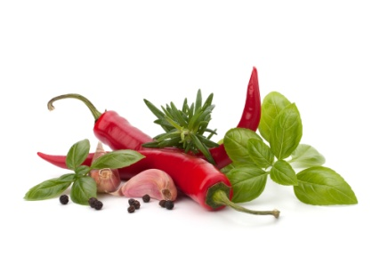
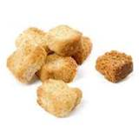

1. Prepare garnishes & accompaniments
Performance criteria:
1.1 Identify menu items that require garnishes and/or accompaniments
1.2 Prepare various garnish and/or accompaniments
1.3 Set up for service
Notes:
Trainer explains each performance criteria for this element to students as listed on slide.

Slide 5
Present and display food products
Terminology:
Read through the glossary of terms
Which terms are you familiar with?
Highlight these terms
Notes:
Trainer to take students through glossary of terms in Trainee Manual.
Activity – Students to highlight any terms that they are familiar with

Slide 6
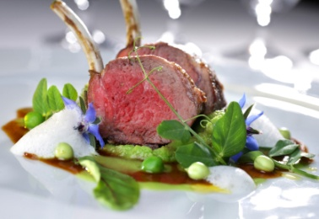
Food presentation
Why is food presentation important?
Considerations for business
Critical aspect of the customers dining experience
Correct presentation techniques allow the food to be displayed to its best potential
Notes:
Trainer to discuss food presentation and quality
Impact of good/bad presentation on the customer
Basics of food presentation

Slide 7
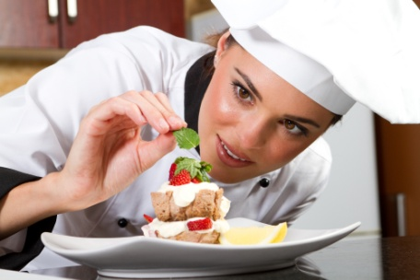
Menu items that require garnishes or accompaniments
Garnish:
An edible food item used to make the dish look more attractive
Served on or in the actual dish
May be integral to the dish or simply used as a decoration
Accompaniment:
A food item used to compliment the flavour or to add texture to a menu item
Served aside from the main component
Notes:
Trainer to discuss/define the differences between a ‘garnish’ and an ‘accompaniment’
Trainer may give examples

Slide 8
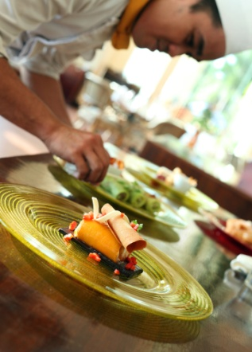
Menu items that require garnishes or accompaniments
Study the menu and recipe requirements
A menu or standard recipe will often describe the type of garnish required for each item
Consider the compatibility of garnishes or accompaniments with the main component of the dish
Discuss presentation requirements with your Chef
Notes:
Trainer outlines the various considerations for selecting garnishes and accompaniments for a variety of menu items.
Outlines and defines a ‘standard recipe’, its implications and uses
Discusses compatibility of foods, flavours, colours and textures

Slide 9
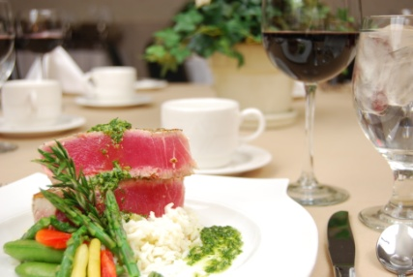
Menu items that require garnishes or accompaniments
Some garnishes or accompaniments may not be described on the menu or in the recipe
These may be placed (at the Chef’s discretion) as a decoration to enhance the presentation of the dish
This may include items such as picked herbs, lemon wedges, or fruit garnishes for desserts
Notes:
Trainer discusses how some garnishes may not need to be described on the menu. Expectation of certain standard garnish or accompanying items.

Slide 10
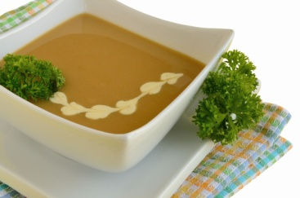
Menu items that require garnishes or accompaniments
Examples of garnish descriptions on the menu include:
Onion soup served with cheese crouton (garnish)
Steamed fish garnished with julienne of root vegetables (garnish)
Mushroom risotto topped with shaved Pecorino cheese (garnish)
Notes:
Trainer provides these examples.
Trainer seeks feedback from students on other (workplace) examples of garnishes described on menus.

Slide 11
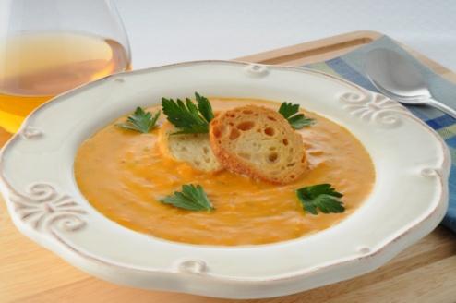
Menu items that require garnishes or accompaniments
Examples of accompaniment descriptions on the menu include:
Carrot soup served with sippets (accompaniment)
Curries with mixed sambal (accompaniment)
Roast beef with horseradish relish (accompaniment)
Notes:
Trainer provides these examples.
Trainer seeks feedback from students on other (workplace) examples of accompaniments described on menus.

Slide 12
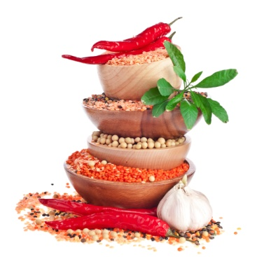

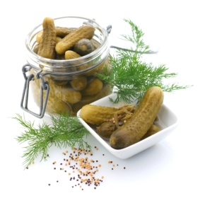
Menu items that require garnishes or accompaniments
Other considerations when selecting garnishes or accompaniments include:
Type of cuisine
Cultural theme and compatibility
Traditional/classical style
Style of service
Notes:
Trainer outlines and explains each point in the slide and describes the importance of each consideration.
Examples may include; rice as an accompaniment to most Asian cuisines, potatoes and pasta to European cuisines.

Slide 13
Menu items that require garnishes or accompaniments
Menu item | Garnish herbs or spices
Fish | Dill, parsley, chives, cilantro (coriander), spring onion
Beef | Parsley, chervil, thyme, oregano
Lamb | Rosemary, mint, parsley, chervil
Chicken | Tarragon, basil, fennel
Desserts | Mint leaves, berries, cinnamon
Soups and stews | Parsley, chervil, chives, cilantro, thyme
Cakes and pastries | Mint leaves, berries, cinnamon, nutmeg
Notes:
Trainer may explain compatibility/incompatibility of flavours, traditional flavour partners to foods.
Explain that this list is not comprehensive but gives a good indicator of appropriate garnish herbs/spices.
May explain the difference between presenting inappropriate items with certain foods (i.e. rosemary with fish or Asian garnish herbs with traditional European cuisine)

Slide 14
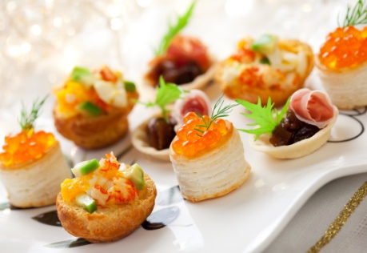
Preparing garnishes
Garnish:
Refers to a food item that is used to enhance the overall presentation of the menu item
Adds colour and texture to the menu item
Makes the dish more visually appealing to the customer
Notes:
Trainer defines a ‘garnish’ and its uses.

Slide 15
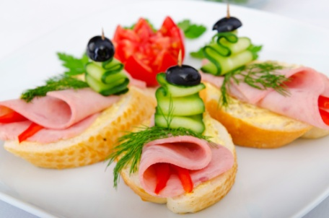
Preparing garnishes
Garnish:
May range from simple food items to quite elaborate artistic creations
May be required for presentation on a plate or for display on a buffet service
Plate garnishes should be fresh, edible and must compliment the menu item being prepared
Notes:
Trainer defines a ‘garnish’ and its uses. (cont)

Slide 16
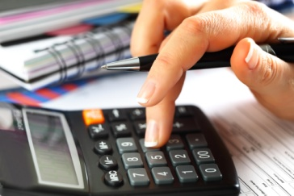
Preparing garnishes
Considerations for selection of garnishes:
The menu item, style and cuisine
The cost and selling price of the menu item
Availability, cost and freshness of products used for garnishes
Equipment required for preparing garnish items
Standard recipe requirements
Notes:
Trainer outlines how garnishes are selected and consideration for selection

Slide 17
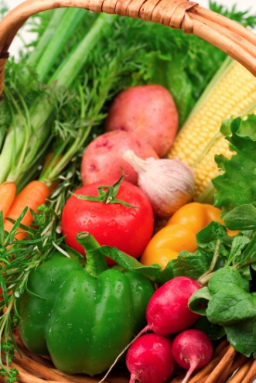
Preparing garnishes
Considerations for preparation of garnishes:
Select fresh looking herbs, leafy greens, fruits or vegetables
Thoroughly wash any herbs, fruits or vegetables that are to be used
Remove any leaves that are dead, withered
Beware of items that may have been chewed by insects or show signs of insect activity
Notes:
Trainer outlines how garnishes are selected and consideration for selection

Slide 18
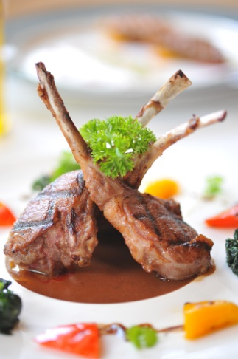
Preparing garnishes
Pick herb sprigs of appropriate size so as not to overwhelm the main ingredient
Peel and trim fruits and vegetables neatly and remove any pips
Cut fruits and vegetables evenly and uniform in shape and size
Ensure that the garnish is edible – some fruits, berries, plants and leaves can be bitter or poisonous
Notes:
Trainer outlines how garnishes are prepared to quality standards

Slide 19
Preparing garnishes
Garnish ingredient | Examples
Fresh herbs | Parsley, chives, chervil, cilantro, dill, basil, mint,
Woody herbs | Fried sage, thyme, rosemary (these are bitter and require cooking)
Edible flowers | Nasturtium, dandelion, zucchini, caper
Edible leaves | Lettuce, spinach, endive, roquette,
Shoots and sprouts | Pea shoots, bean shoots, lotus root,
Vegetables - raw or cooked | Cuts including julienne, brunoise, paysanne, jardinière, noisettes, fried shallots, roasted garlic
Fruits | Segmented citrus, diced, dried, candied
Pastry – short or puff | Fleurons, cases, toppings
Bread | Croutons, sippets
Eggs | Omelette, royale, whole poached or fried
Nuts – whole, toasted, crushed | Coconut, peanuts, walnuts, hazel nuts, almonds
Edible seeds | Poppy, sesame, pumpkin
Chocolate | Shaved, piped filigree, baskets, powder/cocoa
Sugar | Pulled, candy, toffee, praline
Biscuits | Tuille, shortbreads, macaroons
Notes:
Trainer gives overview from table defining different garnish items and categories

Slide 20
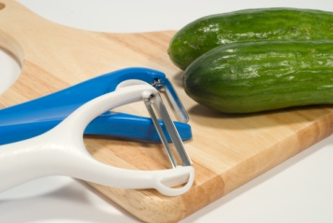
Preparing garnishes
Some specialist equipment for preparing and presenting garnishes or accompaniments include:
Shape/pastry cutters
Parisienne cutters
Zester/channel cutter
Peeler
Mandoline
Piping bags and nozzles
Paring and turning knives
Notes:
Trainer describes selection and use of a variety of equipment used to prepare and shape garnishes

Slide 21
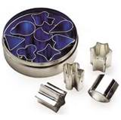
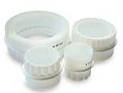
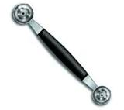
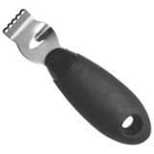
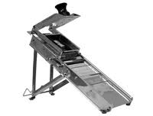
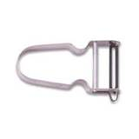
Preparing garnishes
Equipment for preparing garnishes:
Shape cutters | Pastry cutters | Parisienne cutter
Zester | Peeler | Mandoline
Notes:
Trainer describes the use of each pictured item

Slide 22
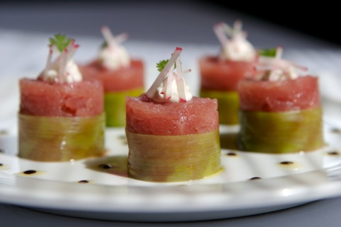
Preparing accompaniments
Accompaniments
An accompaniment is used to add to the texture and taste to a menu item:
Accompaniments should be appropriate and compliment the main food item
Many accompaniments are traditional to certain styles of cuisine
Accompaniments may have some cultural significance or may simply have developed as a common, complimentary ‘partner’ to some foods
Notes:
Trainer defines an ‘accompaniment’ from the listed points

Slide 23
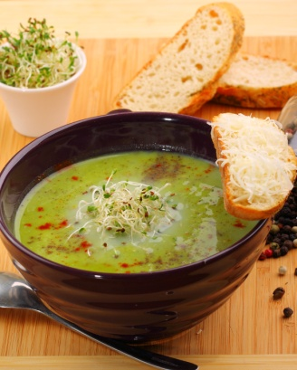
Preparing accompaniments
Some garnishes and accompaniments require preparation following a standard recipe
These may include items such as biscuits or pastry
These items must also be of good quality and appearance – therefore you must follow the recipe precisely
Notes:
Trainer defines an ‘accompaniment’ and uses from the listed points

Slide 24
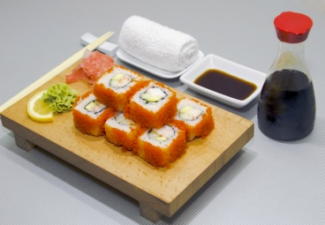
Preparing accompaniments
Many accompaniments can be purchased pre- prepared. These include items such as:
Soy sauce
Wasabi
Mustard
Ketchup
Mayonnaise
Notes:
Trainer defines prepared accompaniments from the listed points

Slide 25
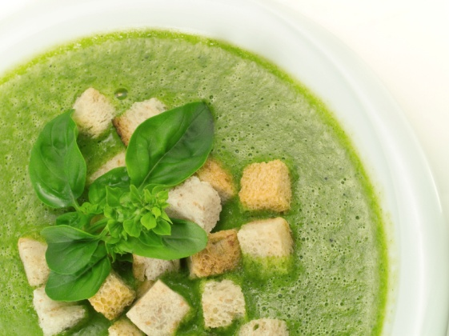
Preparing accompaniments
Other accompaniments may be partially prepared and only require some basic preparation, heating or cooking.
These include items such as:
Fried shallots
Toasted nuts
Chopped chillies
Sambals
Specialty breads
Chocolate and sugar decorations
Notes:
Trainer defines prepared accompaniments from the listed points. May discuss cultural or specific cuisines for accompaniments

Slide 26
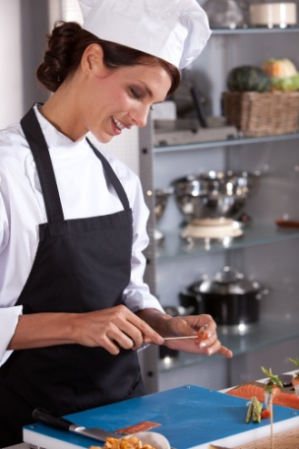
Preparing accompaniments
Accompaniments that require preparation should be made as close to serving time as possible
Dressings and sauces may be made in advance to allow the combination of flavours to develop
As with garnishes, food items used for preparing accompaniments must be fresh and of good quality
Notes:
Trainer describes quality points in preparing fresh accompaniments

Slide 27
Preparing accompaniments
Examples of accompaniments to cuisines:
Cuisine type | Common accompaniments
Japanese | Soy sauce, pickled ginger and wasabi
Italian | Parmesan cheese, vegetable and herb pesto
Indian | Sambals, naan breads, dhal
Mexican | Salsa, guacamole, tortilla, sour cream
Cantonese | Shrimp paste, char siu sauce,
Vietnamese | Nuoc Mam, green banana, bean sprouts
Notes:
Trainer discusses different cuisines and traditional accompaniments using table.

Slide 28
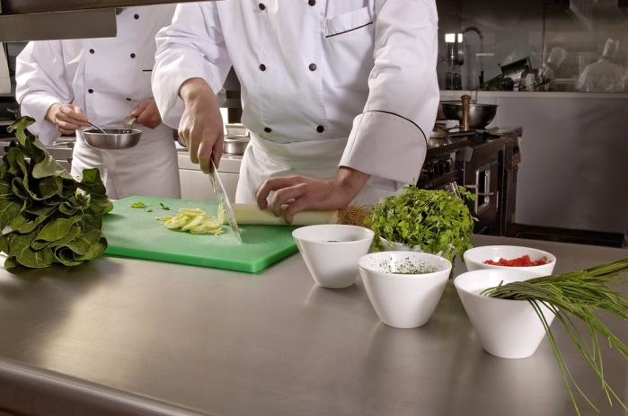
Setting up for service
The term ‘Service’ relates to the period of time in which customers will select, order and consume their meals
Set up procedures will depend upon the type of menu and service style of the business
If correctly laid out and ‘mise en place’ has been properly carried out, the kitchen should function smoothly during the service period
Notes:
Describe the term ‘service’ and how this relates to overall food presentation. Briefly describe types of menus and service styles

Slide 29
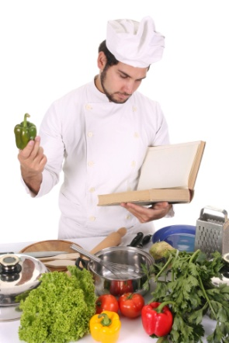
Setting up for service
Some good practices to follow to help ensure that service is carried out smoothly include:
Familiarise yourself with menu items and their components
Have checklists to follow during preparation and leading up to service periods
Report any potential problems as soon as you notice them
Participate in kitchen briefings prior to service
Notes:
Describe procedures to ensure that service is carried out to minimise mistakes or problems prior to and during service

Slide 30
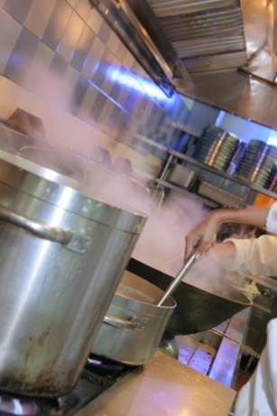
Setting up for service
Calculating quantities of food required for the service period:
Reviewing guest bookings
Reviewing historical sales data
Historical popularity of certain menu items
Observing current trends in food and cuisine styles
Seasonal availability of food products
Notes:
Discuss the importance of calculating food quantities required for food service. Elaborate on each point in the slide.

Slide 31
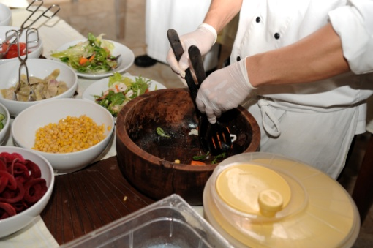
Setting up for service
Setting up stations for food service:
A ‘station’ is a section of the kitchen which may service a particular menu course or specific food items.
A section will require various items/equipment to be available and at hand
This is to meet the need of the particular service period and expected number of diners
Notes:
Give an overview of the term ‘station’.
Describe the different stations in a kitchen and how they interact.

Slide 32
Setting up for service
Items required for service include:
Cooking vessels such as pots and pans
Serving equipment such as tongs, spatulas, ladles, trays
Serving platforms including plates, bowl, trays and platters
Prepared food items such as steaks, fish, poultry, vegetables
Accompaniments and garnishes
Notes:
Outline the various considerations for setting up for service using points in slide.
Describes why these points are critical to smooth workflow and minimising errors during service periods.

Slide 33
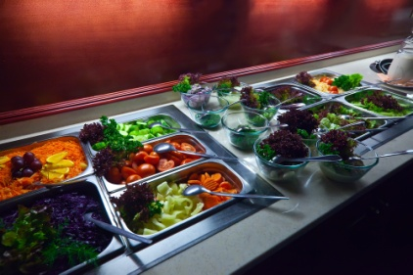
Setting up for service
The term ‘station’ may also refer to sections of a buffet where particular food items are presented and displayed including:
Soups
Appetisers and entrees and salads
Carvery for roast meats
Main course wet or dry dishes
Vegetable dishes
Desserts including pastries and cakes
Notes:
Define the term ‘station’ as it relates to the buffet style of service.
May draw up an outline of a buffet set up showing patron flow and describing its importance.

Slide 34
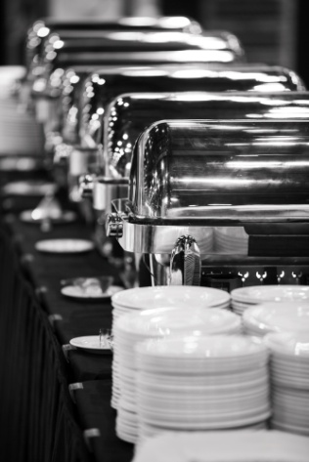
Setting up for service
Equipment required for holding and storage during service periods:
Bains-marie
Chafing dishes
Plate warmers
Hot boxes
Cool rooms
Cold display units
Soup tureens
Notes:
Give an outline of equipment used for the holding and storage of food items during service.
Define which item would suit each service style.

Slide 35
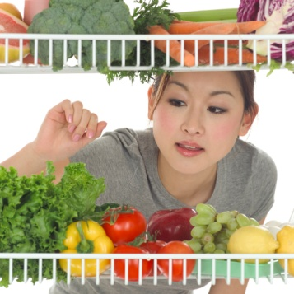
Setting up for service
Back up food items for service periods:
Having back up food items prepared is an important consideration for any service period
This is a common aspect of mise en place
Ensures that food items will not run out
Ensures that customers will not be waiting for long periods for items to be prepared
Notes:
From points in slide, define the term ‘back up’
Describe the importance in relation to customer service and quality standards.

Slide 36
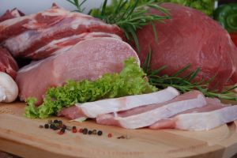
Setting up for service
Examples of backing up menu items include:
Meats such as steaks are cut and portioned:
Processed food items such as crumbed foods are prepared
Processed meat, poultry and seafood items are available
Extra vegetables and other accompaniments such as rice or pasta are par cooked
Additional sauces, accompaniments and garnishes
Notes:
Read through the points in slide.
Seek feedback/examples from students

Slide 37
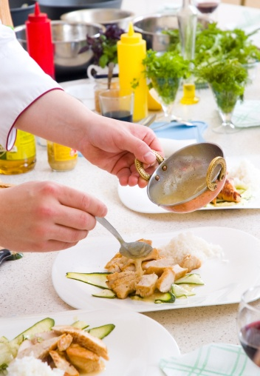
2. Plate and present foods
Performance Criteria:
2.1 Portion food items to enterprise standards
2.2 Provide sufficient and appropriate service equipment and service platforms
2.3 Plate and display food items to menu style
2.4 Present food neatly and attractively
Notes:
Outline to students the second element and its performance criteria.

Slide 38
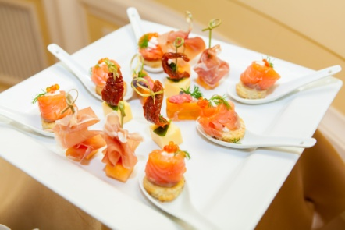
Portioning food items
Portioning and portion control are important aspects of food presentation
Presentation must be consistent in quantity and size
Menu items must be uniform in shape and appearance
Portion sizes or quantities should always be in line with the business policy or standard recipes
Notes:
Define the terms ‘portion’ and ‘portion control’
Describe the importance of consistency using the points in slide.

Slide 39
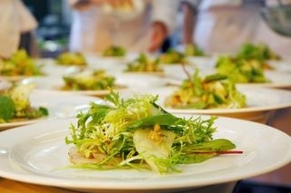
Portioning food items
Portioning refers to the amount of food allocated to a particular menu item
This may include several components to a dish or a single serve item
All dishes of the same type must look the same
The position of the food components should be the same on all plates
Good portion control practices allow the kitchen to control its costs
Notes:
Describe the impact of portion controlling on:
a) customers
b) costs to business

Slide 40
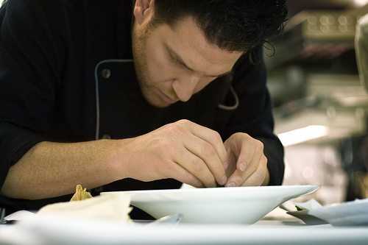
Service equipment and platforms
These are items that are used in the handling, plating, decorating and display of food items
This includes items used for individual plating and larger items for displaying food on buffets
Correct service equipment selection can assist with portion control
Notes:
Overview of service equipment and serving platforms/vessels

Slide 41
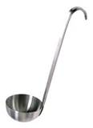
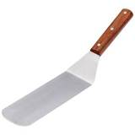
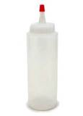
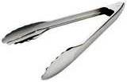
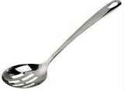
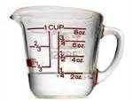
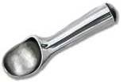

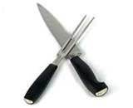
Service equipment and platforms
Examples of service equipment:
Notes:
Describe each piece of equipment and its uses in food service periods.
What types of food would these items be used for when serving?
Seek feedback from students on equipment used in their workplace.

Slide 42

Service equipment and platforms
Service platforms are items used as a base for food presentation
Should be in a clean and sanitary condition
Free of cracks, scratches and chipping
Must be ‘food grade’
Should not have colours or designs that are ‘busy’ or have intricate design patterns
Notes:
Define the term ‘service platform’
Describe quality points to selecting service platforms using points in slide. Elaborate on these points.

Slide 43
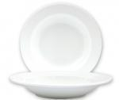

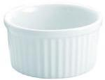





Service equipment and platforms
Examples of service platforms:
Plates and bowls
Platters
Stands
Notes:
Describe each item and its particular uses.
The type/style of service that each of these items would be used for.
Reiterate quality standards for selection of equipment.

Slide 44

Menu styles and plating
Different service styles will usually reflect in how menu items are presented to the customer:
A la carte service involves foods being cooked and plated to order
Banqueting involves pre-cooked foods being plated and served at the same time
Buffet service entails the layout and display of cooked or prepared food items
Notes:
Define each service style in the slide points.
Elaborate on each style of service and provide reasons for different service styles (e.g. Banqueting opposed to A la carte for large groups dining at same time, the issues that would be faced with using an a la carte service style)

Slide 45

Neat and attractive presentation
Care and attention must be paid when plating to ensure neat and attractive presentation
During a service period, a senior Chef will usually quality check each and every dish
Cultural style may impact on how food items are presented
Notes:
Define the importance of ‘neatness’ and ‘attractiveness’, particularly from the customers perspective
Give examples of poor plating and presentation
Describe the impact of untidy or unattractive food presentation on diners and the business reputation.

Slide 46

Neat and attractive presentation
Plating considerations include:
Eye appeal
Colour and contrast
Height and depth
Temperature of food
Service and cuisine style
Classical and innovative arrangement styles
Notes:
Define each point in slide.
Give examples of each point and define the importance of all elements being utilised for food presentation.

Slide 47

Neat and attractive presentation
Notes:
Utilise the picture and seek feedback on all elements being met for presentation of this dish.

Slide 48

Neat and attractive presentation
Drips and spills must be wiped clean
Attention must be paid to placement of food items and garnishes
Poorly plated dishes should be re-plated
Food handlers gloves should be worn to avoid leaving print marks
Notes:
Define the points in slide.
Outline the critical aspects of plating food in relation to quality of presentation.
Point out the impact of poorly plated or poorly presented food on the customer’s opinion of the business standard
Point out the customers expectation when paying for an expected high quality meal.

Slide 49

3. Store garnishes & accompaniments
Performance Criteria:
3.1 Store items correctly
3.2 Store products appropriately in correct containers
3.3 Label products correctly
3.4 Store items in correct conditions to maintain freshness and quality
Notes:
Introduce the performance criteria to the trainees

Slide 50

Correct storage
Prepared foods must be stored in an appropriate vessel and at the correct temperature
Factors that can affect food quality during storage include:
Strong odours from other foods
Humidity
Excess heat, air
Notes:
Ask trainees to suggest what methods might be used to avoid some of these problems

Slide 51

Correct storage
Prepared foods should be well covered or wrapped
Prepared food should always be stored above raw foods and away from strong smelling foods
Ideally, prepared foods should be stored for no longer than 24 hours
Excessive storage time will affect the quality of prepared food items
Notes:
Give an outline of why correct food storage practices are important in relation to quality and hygiene.
Read through and elaborate on each point in slide.

Slide 52

Correct storage
Refrigerated foods should be subject to low humidity and a temperature of between +1°C to +5° C
Ideal freezing temperatures are between -15°C to -18°C
Dry food storage requires foods to be stored in a cool dry area between +18°C to +24°C
Excess humidity can lead to softening of food texture
Excessive dryness in storage can lead to staling
Notes:
Briefly describe the 3 main food storage areas
Define foods that may be stored in each area
Give reference to HACCP based food safety programs where storage conditions are outlined.

Slide 53

Storage containers
Consider the type of container or packaging medium that is to be used
Containers, packaging and wrapping materials must be suitable and appropriate to the food item to be stored
Stainless steel and hard plastics are most commonly used as food storage vessels
Notes:
Give an overview of storage containers used in food businesses.
Read through and elaborate on each point in slide.
Describe how correct selection impacts on food quality.

Slide 54

Storage containers
Glass containers are not recommended for food storage due to the chance of breakage
Other items used for storage and wrapping of food include; plastic cling film/wrap, aluminium foil and silicon paper
All storage vessels or items must be ‘food grade’
Storage vessels must be clean, sanitised and in good condition
Notes:
Read through and elaborate on each point in slide
Outline the term ‘food grade’ and discuss items that may not be suitable for food storage

Slide 55

Labeling food items
All prepared foods should be clearly labelled prior to storage.
This practice will assist to:
Identify potentially contaminated food
Indicate poor or low quality food
Identify freshness of prepared food items in storage
Notes:
Outline the requirements for labeling of foods in storage
Read through and elaborate on each point in slide
Give some examples/repercussions of having unlabeled food in storage

Slide 56

Labeling food items
Label information should include:
Name of the item
Date the item was first stored
Time the item was first stored
Temperature – if being process-tested
Type of storage – chilled, frozen, thawing
Writing must be legible and the label must be some fixed to the container in some way
Notes:
Read through each point in slide.
Give examples of types of labels available for food storage.

